Slide 1


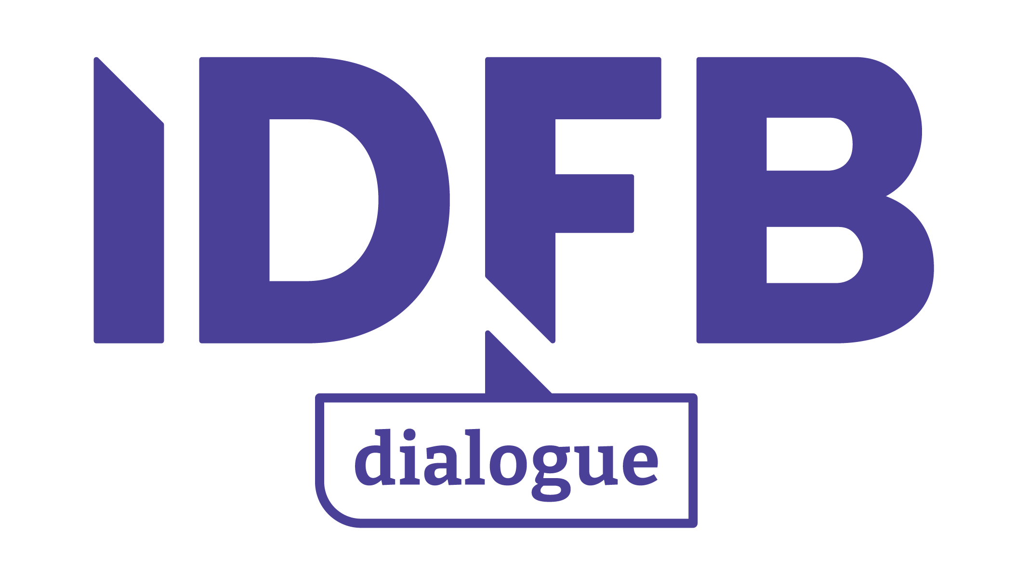
The Interface Dialogue
Finance & Biodiversity

Slide 2
Programme of today
15:00 – 15:25 | Caroline van Leenders opens with an introduction to the IDFB and Locally Led Finance
15:25 – 15:30 | Ramson Karmushu on the Reversing the Flow Programme in Kenya
15:30 – 15:50 | Aaron Vermeulen and Sandra Valenzuela of WWF Colombia on the Herencia Colombia project
15:50 – 16:00 | Discussion
16:00 – 16:05 | Break
16:05 – 16:25 | Samantha Power on Bioregional Finance Facilities
16:25 – 16:40 | Q&A
16:40 – 16:55 | Caroline van Leenders presenting the IDFB Roadmap and other updates
16:55 – 17:00 | Closing words

Slide 3
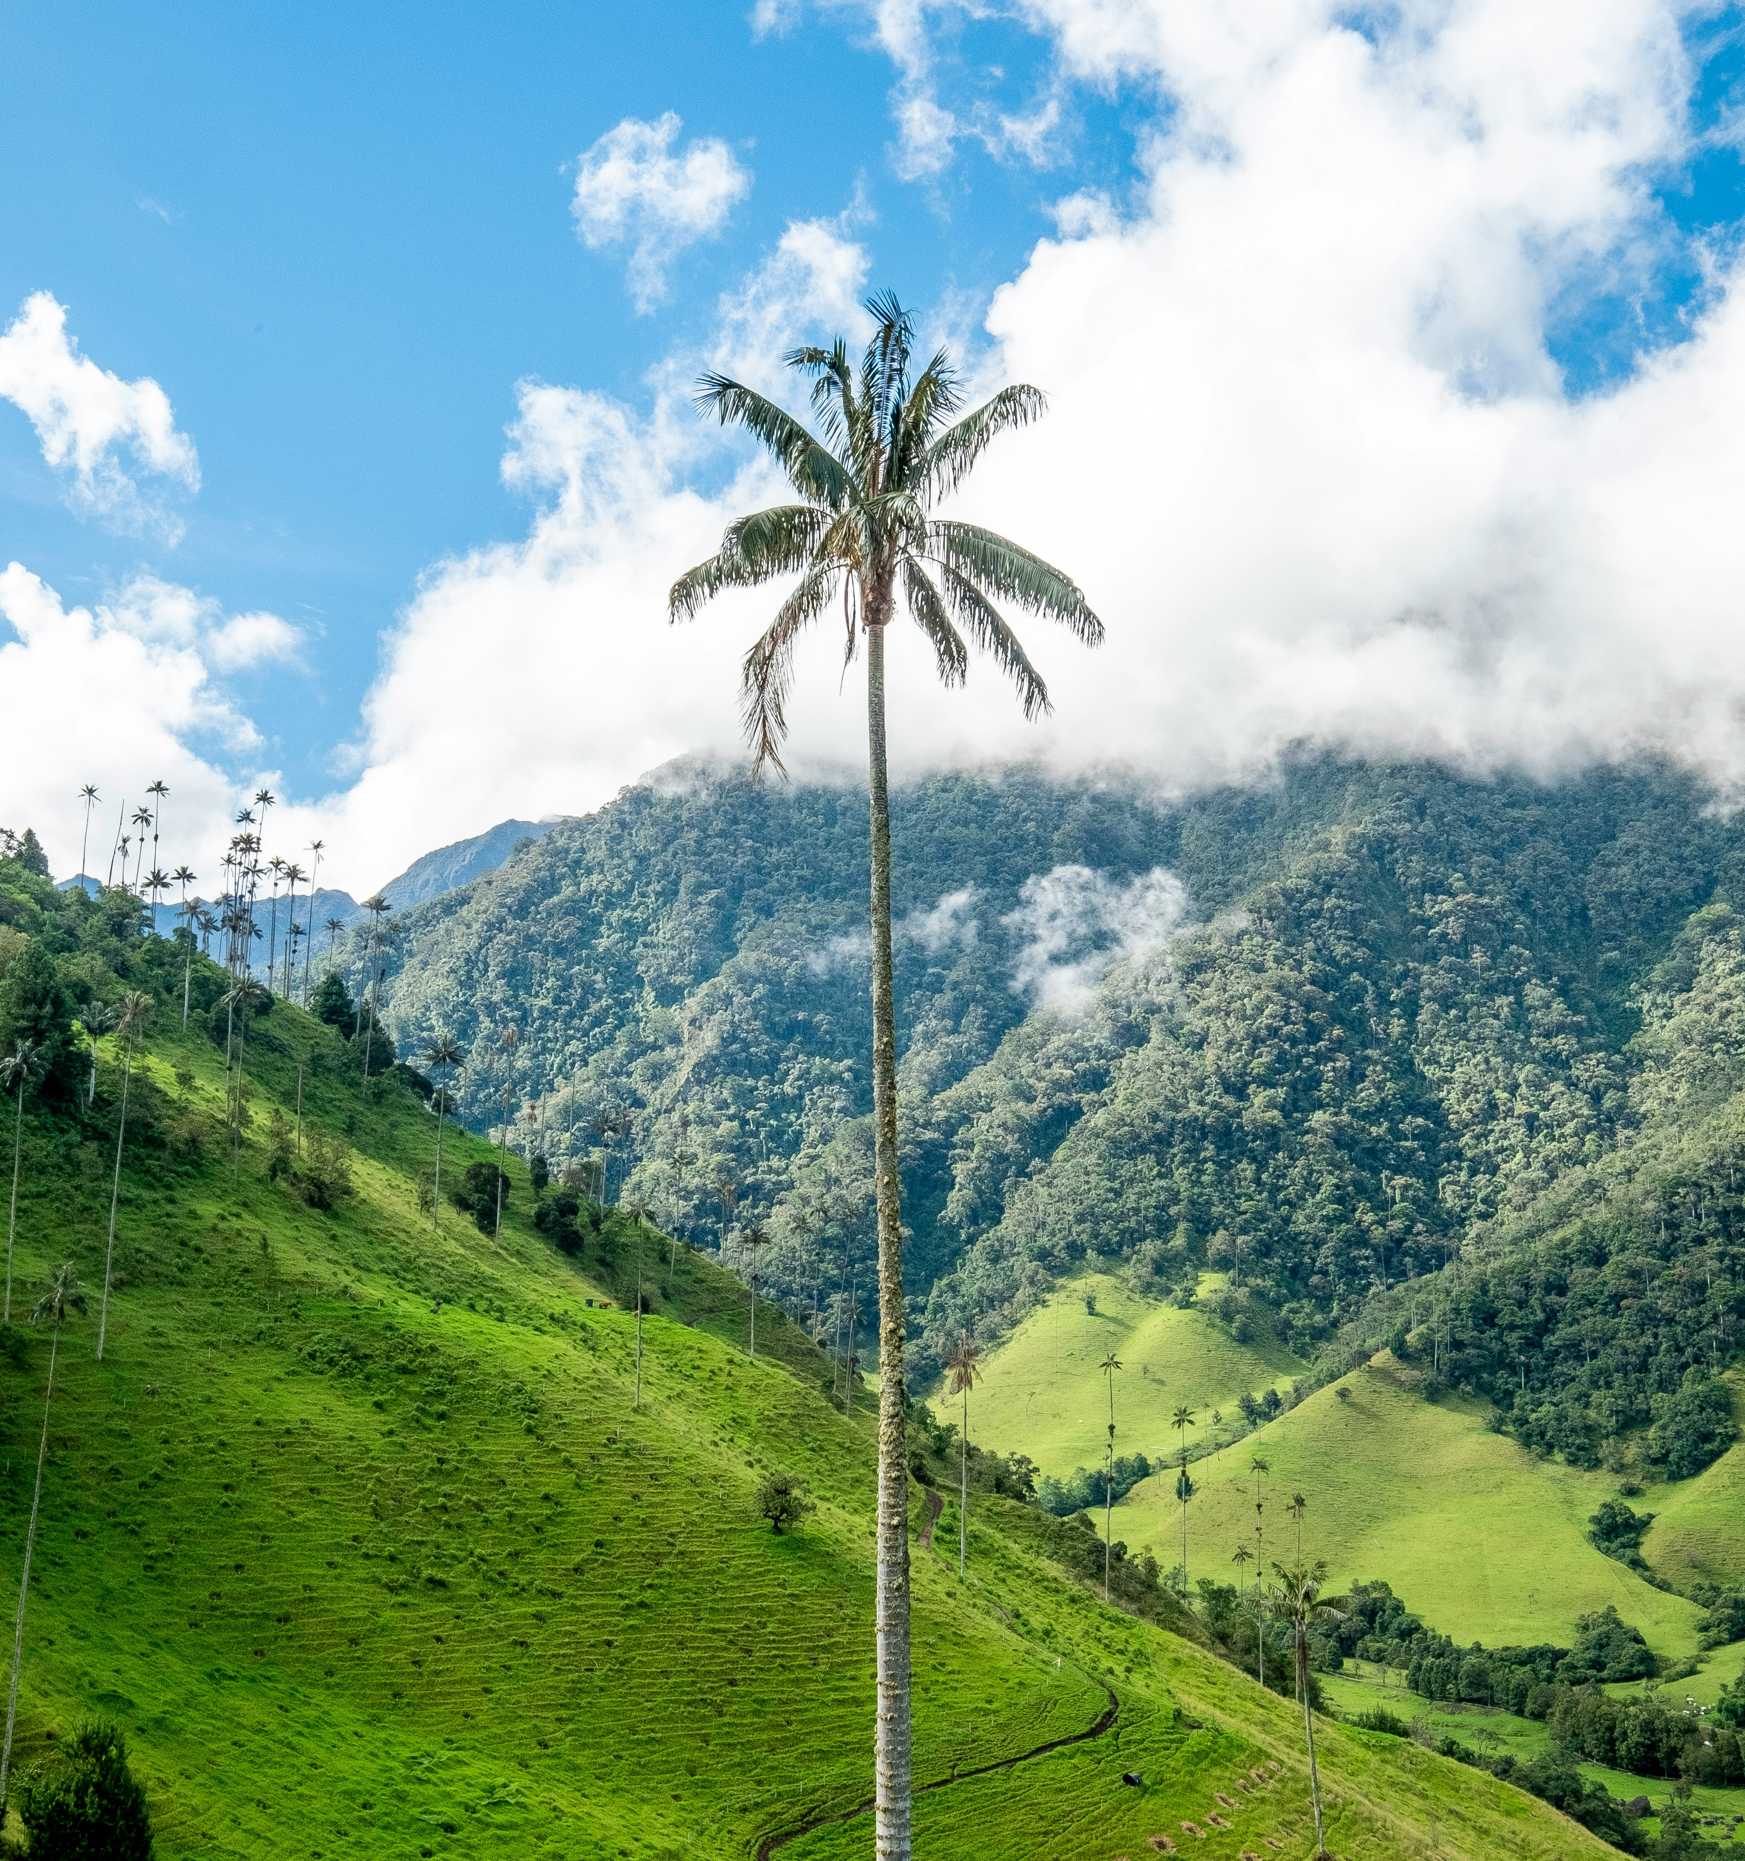
About the
Established in 2021, by the Dutch Government, in the run up to COP15 to bridge the gap between greening finance and financing green
The IDFB hosted 15 dialogue sessions to bring together perspectives from the public sector and private financial sector
More than 30 countries and 60 experts engaged in the dialogue sessions, where lessons and best practices on resource mobilisation and engaging the private sector were shared
The IDFB helped to get the alignment of all public and private financial flows in the text of the GBF and developed 10 recommended actions to accelerate alignment

Slide 4
Setting the scene of today’s Dialogue Session
Locally-led financing: An important part of the upcoming negotiations is local involvement within decisions on finance for nature
Key findings from the IDFB paper on developing blended finance capacity for nature
Blended finance is the most impactful way to mobilize private investment, raise additional finance, whilst leveraging limited public funding
Nature is context-specific, thus we need to explore more solutions and develop domestic markets for blended finance to mobilize private finance for biodiversity
Domestic blended finance facilities that are designed to meet the needs of specific biomes and local needs can facilitate finance that suit the priorities and commitments of individual countries
New solutions should build on existing facilities, vehicles and financial infrastructure to avoid duplication, maximise synergies, and reduce transaction costs
We must take a whole-of-society approach to including IPLCs and other stakeholders when designing governance structures of blended finance solutions
Capacity building and technical assistance are key for setting up blended finance solutions
Where countries have constrained availability of domestic resources, additional public or philanthropic resources must be made available

Slide 5
Introducing Reversing the Flow
The Reversing the Flow Program is supported by the Netherlands Enterprise Agency (RVO) and the Ministry of Foreign Affairs (BuZA)
RtF helps communities by championing inclusive, locally-led water management, nature-based landscape restoration, and climate adaptation to build resilient livelihoods
Local partners are organized in hubs to support communities in leading these initiatives themselves in 5 countries: Bangladesh, Burkina Faso, Ethiopia, Kenya, and Sudan
The programme has three key pillars:
1. Funding for local organizations via small grants mechanisms for grassroots actions
2. Facilitating knowledge development and learning across communities within watersheds and landscapes; between communities and governments, utility companies, development parties, and other landscape actors; and between landscapes and hubs at the programme level
3. Engaging policy dialogues on investments in landscapes at the multilateral, national and local levels to ensure interventions are sustainable and inclusive

Slide 6

Is more attention for locally led financing needed in implementing the Global Biodiversity Framework?
Do you have practical examples of best practices for locally led finance for nature?

Slide 7
Q&A

Slide 8
Results of the
Results of the IDFB 2024
Sharing knowledge and experiences linked to finance for nature and implementing the GBF
Facilitating informal discussions through Open Office Hours where members of the network can meet each other, exchange ideas and discuss topics and challenges
Providing a space for dialogue and learning through Dialogue Sessions with other resource mobilisation professionals on the topic of aligning all financial flows for nature. After each session, a meeting report will be published.
Additional support for developing National Biodiversity Finance Plans through the publication of a guidance document, based on the work of BIOFIN.
Insight into best practices and lessons learned, which will be collated and made available on the IDFB website.
Staying up to date on relevant events planned for COP16 (and the lead up to it), with over 15 events shared on the IDFB Roadmap to Cali

Slide 9

Insights from the Open Office Hours
Participants: Uganda, Japan, Switzerland, France, South Africa, Egypt, the Democratic Republic of the Congo, Germany, Norway, Malta and the European Commission
Four topics were highlighted in these Open Office Hours:
Interest in extra guidance on National Biodiversity Finance Plans
This will be published by the IDFB in the coming month
Case studies and best practices for biodiversity finance
The IDFB Team is working on collating best practices to share on the IDFB website
Questions on T15 on transparency and disclosure, and T20 on capacity building
The IDFB is of the opinion that the work being done by BIOFIN is leading on for this question. We continue to share work being done by the network of partners on these topics on the IDFB website
Digital Sequencing Information (DSI) on genetic resources and the involvement of the private sector
The IDFB Team will take up this point of interest and report back any findings on the IDFB Helpline

Slide 10

on the road to – and at – COP16
In the run up to COP16 in Cali, Colombia the IDFB will host three new dialogue sessions (two more to come)
The IDFB Website will share important events on the road to COP16 and resources published by partners and key organizations (now featuring over 108 reports)
The IDFB will publish a guidance document on NBFPs based on the work of BIOFIN
Official side events
Dutch Water Pavillion
Finance Day

Slide 11
Upcoming Dialogue Sessions
In the run up to COP16 in Cali, Colombia the IDFB will host two more dialogue sessions. Key topics may include:
  Effectively dispersing big money for local-level impact
  Finance mechanisms for nature including Payment for Ecosystem Services
We would like to engage on topics that we consider important but that are not receiving sufficient attention in the other dialogues & preparations for COP16
What topics do you think need more attention in preparation of COP16?

Slide 12
The guidance on NBFPs
Content of the paper
Timeline of publication
20th August – 16th September: Integrating feedback
17th September: First draft shared with IDFB Community, members are invited to provide feedback and comments
8th October: Closure of feedback paper and discussion of thoughts during IDFB 17
COP16: Publication of the updated guidance document on NBFPs
Additional guidance on implementing the BIOFIN process for NBFP development
Recommendations for different parts of the NBFP development process based on lessons learned from other countries and experiences with landscape finance approaches

Slide 13

Contact details
Caroline van Leenders Alexander Verkerk
Transition Broker Biodiversity & Finance Senior Policy Officer International Biodiversity & Finance
Ministry of LNV / Netherlands Enterprise Agency Ministry of LNV
email: caroline.vanleenders@rvo.nl email: a.j.o.verkerk@minlnv.nl
IDFB Secretariat
Eli Morrell & Iris Visser
email: info@idfb-dialogue.org
IDFB-DIALOGUE.ORG

