Slide 1
State of Finance for Nature
Scaling up finance for nature-based solutions
Nathalie Olsen, Climate Finance Unit, UNEP
13th session of the Interface Dialogue Finance and Biodiversity
25 Oct 2022
Notes:
Our work on finance for nature focuses on the rôle of NbS, working with the natural world, with ecosystems, to address a range of social, economic and environmental challenges.
We look at current flows from all sources to NbS and compare to estimates of what finance is needed to limit climate change to 2C, halt biodiversity loss and achieve land degradation neutrality.
We are all aware of the planetary crisis we face. The signs and impacts of biodiversity loss, climate change and land degradation are pervasive and increasing extreme with huge impacts on people, ecosystems, resilience, health, economies.
And these impacts create material and systemic risk for governments and the global financial landcape.
We urgently need to tackle these crises with all the knowledge, tools and resources at our disposal.

Slide 2
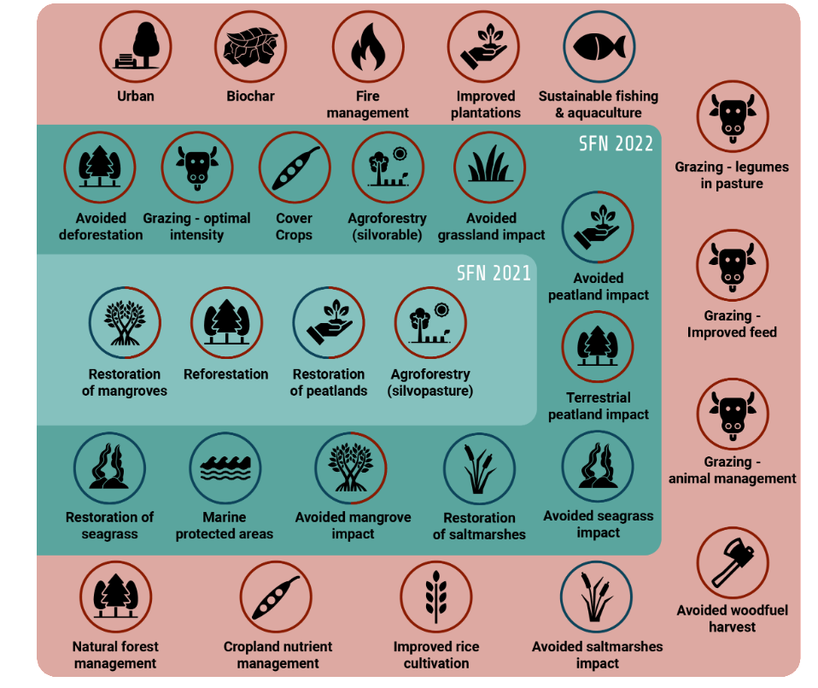
NbS – opportunities to simultaneously tackle climate change, biodiversity loss and land degradation
“actions to protect, conserve, restore, sustainably use and manage natural or modified terrestrial, freshwater, coastal and marine ecosystems, which address social, economic and environmental challenges effectively and adaptively, while simultaneously providing human wellbeing, ecosystem services and resilience and biodiversity benefits”.
Notes:
NbS are central to achieving the Sustainable Development Goals (SDGs) and tackling the global crises of biodiversity loss, climate change and land degradation.
They can deliver multiple benefits for people and the environment. For example, mangrove restoration provides a vast range of benefits from protection against storm surges and coastal erosion, to effective storage of carbon in biomass and sediment, to providing habitat for wildlife and nurseries for young fish, providing food and fuel for local communities. They represent the triple win to tackle climate change, biodiversity loss and poverty.
And it should be noted that some challenges, such as climate change mitigation, cannot be fully addressed without NbS playing a part. Over 30% of emissions reductions to keep climate change below 2C can come from natural climate solutions like reforestation of degraded land with native species.
Growing recognition of the value of NbS is reflected in international declarations and initiatives, national strategies and policies, public sector statements, and private sector commitments and investments.
And yet finance for nature and NbS remains a binding constraint
______________________________
In essence, NbS involve working with the natural world to address a range of social, economic and environmental challenges.
There are 3 key elements:
NbS involve working with different types of ecosystems, from forests to wetlands and from farmlands to urban ecosystems.
NbS work with ecosystems in three main ways: ecosystem conservation, restoration and management.
NbS are solution-oriented. They address a range of social, economic, and environmental challenges, including inequality, unemployment, disaster risk, (In SFN we focus on the challenges of land degradation, climate change, and biodiversity loss)

Slide 3
Current finance flows to NbS
Notes:
SFN provides an overview of current flows of finance to NbS from private and public sources
This years edition includes finance flows to marine NbS and provides more detail on funding of protected areas (with more detail later)
Total flows are USD 154 billion per year
Of this, governments provide 83% with $126 b in domestic expenditure (dark green area) and $2 b (pale blue) in ODA
Of government expenditure, most goes to protection of bd and landscapes, sustainable agric, forestry and fisheres and sustainabl mgt of land and water resources
Private flows are only $26 billion p.a. (17% of total NbS finance)
Investments into biodiversity conservation from sustainable certified commodity markets are the largest component at $8 billion pa,
followed by bd offsets ($6 billion) and
Impact investing (equity and debt investments intended to generate positive measurable ESG impacts and financial returns) $3 billion pa
PES $3 billion pa
Carbon markets ($2 billion pa)

Slide 4
Annual current finance flows to NbS and negative flows (USD billion per year)
$154 billion
Current
Agriculture ($140-510 billion )
Energy ($340-530 billion)
Fisheries ($15-17 billion)
Notes:
Here we see again the $154 billion annually spent on NbS.
We also reviewed published studies of public finance flows that are potentially damaging to nature to compares with finance that benefits nature.
There is increasing recognition of the extensive damage to nature of government fiscal support to some economic sectors, notably fossil fuels, agriculture and fisheries. See graph. The magnitude of fiscal support in the form of subsidies is very large and seriously undermines efforts to increase finance flows to NbS. In short, nature negative flows are 3-7 times bigger than finance flows to NbS.
The absence of robust and comprehensive data on the impact of private finance flows on nature prevented the inclusion of estimates in this edition. However, given the likely very large negative impact of private finance flows on nature, future editions will prioritise inclusion of emerging data and analysis. Similarly, challenges linked to data and conceptual framing make it difficult to estimate NbS negative finance flow in an equivalent manner to NbS so the analysis below is framed around nature-negative financial flows. Nature negative finance flows do not mirror positive financial flows to NbS and so a net flow to NbS cannot be derived from these estimates.

Slide 5
Annual current finance flows to NbS, negative flows and investment needs (USD billion per year)
Public flows
$370 billion
$154 billion
$210 billion
Private flows
Current
2025
Agriculture ($140-510 billion )
Energy ($340-530 billion)
Fisheries ($15-17 billion)
Notes:
A second key part of the analysis was to estimate what investment in NbS would be needed to achieve select Rio Convention targets, namely:
Halting biodiversity loss by 2030
Reaching land degradation neutrality by 2030
Limiting global warming to below 2C
Investment needs were estimated to be $370 billion per year by 2025, which is more than double the current level of $154 b p.a.
So we urgently need to more than double finance flows from all sources by 2025.
Given fiscal constraints on governments, particularly in light of growing poverty and inequality, food security and energy crisis, as well as the continued fall out of Covid and increasing debt levels, much of this increased finance will need to come from the private sector.
The share of finance from the private sector is going to have to increase from current levels at $26billion to cover most of the $210 billion finance gap in 2025.

Slide 6
Annual current finance flows to NbS, negative flows and investment needs (USD billion per year)
$600 billion
$430 billion
Public flows
$370 billion
$154 billion
$210 billion
Private flows
Current
2025
2030
2050
Total
Agriculture ($140-510 billion )
Energy ($340-530 billion)
Fisheries ($15-17 billion)
Notes:
Investment needs were also modelled to 2030 and 2050.
Annual finance flows to nature need to triple by 2030 (to $420 billion) and to quadruple to$600 billion by 2050 if we are to effectively tackle biodiversity loss and climate change.

Slide 7
Annual investment needs by NbS intervention (2025-50), $ billion
Notes:
The estimation of investment needs to limit climate change to below 2C, halt biodiversity loss and reach land degradation neutrality by 2030 is based on modelling.
MAgPIE is a partial equilibrium land use model which is spatially explicit and solves for the least-cost allocations of land uses and investment in technical change to meet future demand for food and commodities, based on assumed population, gross domestic product (GDP) and dietary trajectories.
The model allows for land to be protected and set aside (30by30). It produces a land use change raster based on policy assumptions, such as carbon pricing and land related policies. MAgPIE also accounts for biophysical constraints on yield, land and water.
A range of NbS interventions can be implemented to deliver key climate, biodiversity and restoration outcomes. While forest-based solutions such as reforestation and avoided deforestation, comprise 35 per cent of total annual investment in 2025, other NbS measures can further contribute to international commitments. For example, agroforestry techniques, cover crops in agriculture and optimal managed grazing in pastureland can help improve soil fertility and prevent land degradation and make up one fifth of investment needs in 2025. They have already been explicitly listed in countries’ voluntary land restoration targets as part of the Bonn Challenge, the Rio Conventions and regional initiatives such as the African Forest Landscape Restoration Initiative
This slides shows what types of NbS and how much of them is needed to deliver the emissions reductions needed and to achieve land degradation neutrality (the net effect of land use conversion and restoration) assuming 30% of the planet is protected by 2030 and remains so to 2050.

Slide 8
Finance gap to manage existing marine and terrestrial protected areas by region (USD million per year)
Notes:
The SFN report this year also includes some detailed analysis of protected area finance by Prof Anthony Waldron at the University of Cambridge.
He has collected data on financing of marine and terrestrial protected areas by region and has also calculated what is needed to adequately manage the current system of PAs.
This slide displays some of this information and particularly how globally, current funding of terrestrial PAs in more in line with funding needs than for MPAs. In MPAs, funding would need to increase 5 times to be sufficient.
The size of the finance gap to manage existing protected areas adequately varies by type of protected area and by region.
The current marine PA system is underfunded by a factor of six compared to the terrestrial PA system.

Slide 9
Finance gap to reach 30x30 by region (USD million per year)
Notes:
The 30x30 target proposed under the Global Biodiversity Framework aims to galvanize urgent and transformative action by governments and society.
The annual finance gap to increase the current area under protected areas (PAs) to 30 percent of the planet by 2030 is estimated to be USD 20-26 billion per year.
The finance gap for marine protected areas to reach 30*30 is USD 10-14 billion. Expansion of MPAs to 30 % of the ocean requires current coverage of about 8% to quadruple.
The finance gap for terrestrial protected areas to reach 30*30 is USD 10-12 billion. while terrestrial coverage needs to double from current levels of 15-16 per cent.
The gaps are calculated as the difference between annual spending and annual finance needs, based on management costs to operate an expanded network of protected areas and costs to cover shortfalls in the management of existing protected areas.

Slide 10
Key messages
1. NbS can cost effectively deliver on climate, biodiversity and land restoration targets, particularly if investments contribute to biodiversity (NBSAPs), climate (NDC) and restoration (LDN) targets.
3. Much of the NbS finance gap must be filled by the private sector, both businesses and the financial sector, given government debt and fiscal constraints.
4. Reform and repurposing of environmentally harmful expenditures is urgent - they are 3-7 times the volume of investment in nature and undermine efforts to conserve and sustainably manage biodiversity.
2. Annual current finance flows to NbS must urgently double to 2025 if we are to halt biodiversity loss, limit climate change to below 2C and achieve land degradation neutrality by 2030
Notes:
2. This ‘double’ or ‘triple’ win potential is particularly alluring given the tight economic situation at present.

Slide 11
Recommendations
1. Lock in critical targets on biodiversity loss and take urgent action to implement existing targets to combat climate change and land degradation.
=> Targets should be anchored in national regulation/legislation and finance made available to close the investment gap on NbS.
=> Embed precise, verifiable targets for nature-based solutions in NBSAPs, BFPs, NDCs, restorations commitments.
=> Provide the enabling environment through regulation and economic incentives to catalyse private sector investment in nature
2. Finance green - Increase finance flows to NbS and nature
=> Review government expenditure and ODA through nature positive-negative lens and transition to nature positive
=> Government and MDBs to increase volume of grant and concessional finance to catalyse private investment
=>MDB-IFIs to prioritise green finance in lending and investment, scale up debt for nature swaps
=> Increase private investment in sustainable supply chains, nature markets (to offset unavoidable impacts), pay for ecosystem services
=> Increase number of commercially-viable nature positive projects (technical, economic and regulatory incentives)
=> Unlock institutional investor capital (credit ratings, liquidity, listing of funds) through natural capital asset class

Slide 12
Recommendations
3. Greening finance –governments, business and financial institutions to transition to net zero, nature positive and equitable and to align financial flows with Rio Convention goals
=> Accelerate reform of harmful public financial flows, particularly environmentally harmful subsidies
=> Improved accountability, assessment , measurement, reporting and disclosure of impact and dependencies on nature (TNFD, SbT))
=> IFIs/MDBs to remove climate and nature negative lending and investment from their portfolios (Paris Agreement and GBF alignment)
4. Increase inclusion in financial systems for a just transition
=> Public and private sector NbS investment needs to integrate just transition principles and safeguard human rights
=> Increased finance to be combined with better access to funds and markets by women and other marginalised groups
Notes:
Corporate commitments to ‘net zero’ should not be a substitute much-needed deep emission reductions
On Paris alignment, research by S&P Global showed that only 11% of the 12,000 funds (with total assets under management of USD 20 trillion) is aligned with the Paris Agreement to keep temperature rise well below 2C. More revealing, funds that are branded as ESG or even more specifically ‘climate-themed’ funds are not doing any better. Of the 51 climate-focused funds, representing USD 30 billion AUM, only 10% were Paris aligned. Labeling funds as sustainable alone is not an accurate or reliable measure to determine whether the assets under investment will drive down emissions.
(S&P Global 2022)
4. Develop an asset class for “Nature-based solutions”: common standards, metrics, etc
=> Regulatory efforts (e.g. EU Taxonomy on Sustainable Finance
=> Voluntary industry standards (e.g. Climate Bonds Initiative)
=> E&S Key Performance Indicators; minimum positive impact; alignment private investment with Rio Conventions

Slide 13
Thank you
...........................................
nathalie.olsen@un.org

Slide 14
Cumulative investment needs by NbS activity 2023-50
Notes:
USD 9.5 trillion is needed cumulatively from 2022 to 2050 to keep climate change below 2°C, stabilize biodiversity levels and achieve land degradation neutrality.
More than two thirds of investment is needed for reforestation and agroforestry.
Investment in protected areas requires USD 1.3 trillion (14 percent of total investment needs).
Seagrass and peatland restoration require USD 840 billion and USD 320 billion respectively (12%).
Other agriculture related NbS such as cover crops and optimal intensity grazing absorb USD 360 billion (4 percent).

Slide 15
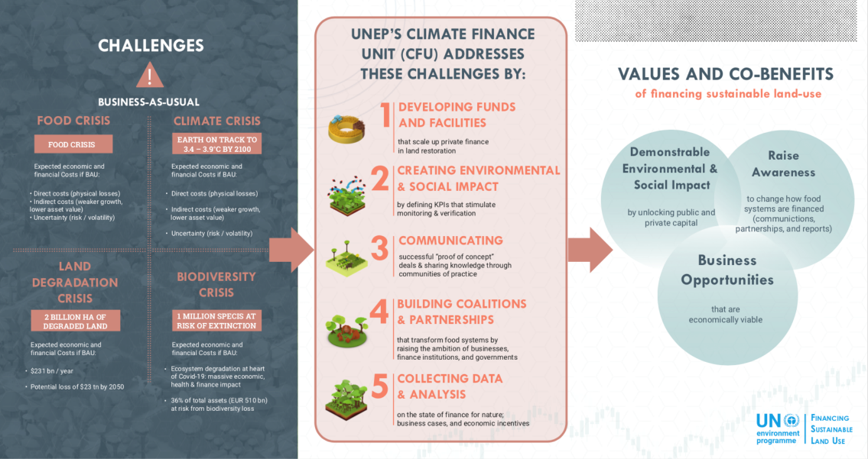
UNEP Climate Finance Unit: Who are we? What are we doing?
2

