Slide 1
INCREASING THE NATURE ALIGNMENT OF GLOBAL FINANCE
“
“
Aligning Global Finance with nature positive outcomes is at the core of NatureFinance’s mission.
Financial decision-making needs tools to transition to a green economy; we are developing a first of its kind
Global Nature Positive Alignment Index and Dashboard

Slide 2
SOME KEY DEFINITIONS
ALIGNMENT WITH NATURE
The extent to which private and public financial flows are consistent, or inconsistent, with achieving the goals of agreed international frameworks for transition to a nature positive world, including the UN Convention on Biological Diversity’s post-2020 Global Biodiversity Framework (GBF).
NATURE POSITIVE
We have adopted a provisional IUCN definition:
“A Nature-Positive future means that we, as a global society, halt and reverse the loss of nature measured from its current status, reducing future negative impacts alongside restoring and renewing nature, to put both living and non-living nature measurably on the path to recovery.”

Slide 3
NATURE WILL PLAY A PIVOTAL ROLE IN FINANCIAL DECISION MAKING IN THE NEXT FIVE YEARS
Nature Markets produce US$7.3 trillion worth of goods and services, equivalent to 8.6% of Global GDP
The move to build nature into finance is happening now, driven by both regulation (TNFD, SFDR) and investor demand.
Nature and climate are increasingly seen as inseparable, and financial institutions need to address them jointly to manage risk and capture new opportunities.
(Dasgupta Review)

Slide 4
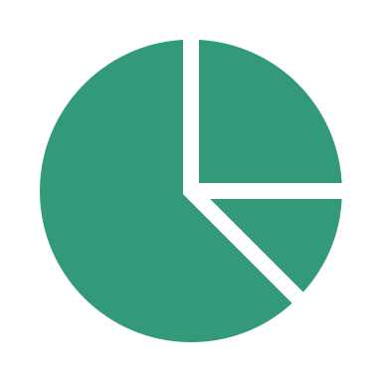
GOVERNMENTS NEED TOOLS TO MEASURE NATURE ALIGNMENT & DEVELOP STRATEGIES TO INCREASE IT
CBD AND NATIONAL REPORTING
Governments need to address requirements around measuring and reporting nature alignment of their National Biodiversity Finance Plans under the Post-2020 Global Biodiversity Framework.
Ministries need to assess and report nature alignment of their expenditure plans, increasingly important with the international push towards tracking public finance flows into nature and climate.
PUBLIC EXPENDITURE PLANS
Public sector managers want to build public expenditure plans that account for nature alignment and delivering on their biodiversity targets.
Government officials want to account for nature when making funding allocation and investment decisions.
ASSESSMENT AND SCENARIO BUILDING
Governments want to assess alternative scenarios to increase the nature alignment of their expenditure and develop transition strategies and plans for a nature positive, net-zero future.

Slide 5
NATUREFINANCE IS DEVELOPING A TOOL THAT SUPPORTS NATURE-POSITIVE, NET-ZERO PATHWAYS
A
B
The NatureFinance Alignment tool leverages existing climate alignment tools used by governments and financial institutions.
The tool allows public sector officials to integrate nature alignment measures into their existing climate reporting efforts, such as their NDCs.
The tool’s ability to integrate additional metrics and frameworks enables governments to use alignment metrics for wider reporting and policy recommendations.
Nature-related reporting and assessment tools
(e.g. TNFD, SFDR)
Climate finance alignment tools
(e.g. PACTA, MSCI Paris-Aligned Index)
NatureFinance
Alignment
Tool

Slide 6
NATUREFINANCE’S QUANTITATIVE TOOL ASSESSES THE NATURE ALIGNMENT OF FINANCIAL FLOWS
COUNTRY ASSESSMENT*
Government Expenditure
Bonds/Loans
Grants and Subsidies
FINANCIAL FLOWS
ALIGNMENT
SCORE
Bilateral/multilateral aid
Donor Funding
SECTOR ASSESSMENT**
Other finance sources
*Country assessment uses data from the Global Green Growth Initiative (GGGI) and Global Footprint Network (GFI)
**Sector assessment uses data from OECD’s CRS, ENCORE and Science-based targets for nature(SBTN)

Slide 7
THE COUNTRY ASSESSMENT IS BASED ON THREE PARAMETERS TO EVALUATE ITS BIODIVERSITY RISK (1/2)
Species intactness
COUNTRY ASSESSMENT
Measures the presence of biodiversity in the country. We see investments in high biodiversity countries requiring greater alignment.
Data source: National Biodiversity Index (NBI) calculated by CBD.
Nature intensity is calculated as nature use per unit of GDP, using estimates of land and water use per unit of GDP, each priced according to their estimated nature impact.
Data source: EORA’s country footprint data
Nature use intensity
Country ecosystem vitality
Assesses a countries’ actions toward retaining natural ecosystems and protecting the full range of biodiversity within their borders (ie country’s environmental performance).
Data source: Yale University’s Environmental Performance Index (EPI)

Slide 8
THE SECTOR ASSESSMENT ANALYSES IMPACTS OF UPSTREAM & DOWNSTREAM ACTIVITIES (2/2)
SECTOR ANALYSIS
Upstream & downstream
Land, Water,
Sea Use Change
Terrestrial Ecosystem Use
Data source: SBTN and ENCORE are used to assess sector level materiality.
The framework provides upstream, operations and downstream score for each sector and we have used average scores across the value chain for each sector.
Freshwater Ecosystem Use
Marine Ecosystem Use
Resource Exploitation
Water Use
Climate Change
GHG Emissions
Non GHG Emissions
Pollution
Water Pollutants
Soil Pollutants
Solid Waste
Invasives
Disturbance

Slide 9
CURRENT DATA COVERAGE STATUS
PUBLIC DEBT Substantial (especially G-20)
DEVELOPMENT FINANCE Substantial
PUBLIC EXPENDITURE Partial
RISK MITIGATION Limited
PRIVATE EQUITY Limited

Slide 10
THE TOOL WILL OFFER THREE ANALYTICAL COMPONENTS ON NATURE ALIGNMENT
INDEX
DASHBOARD
POLICY
RECOMMENDATIONS
A Global Alignment Index, assessing the alignment between global financial flows and nature positive outcomes.
The Index can be granular to a public and private finance, global, national, individual financial institution or corporate entity level.
An interactive, web-based Dashboard built around the Global Alignment Index.
Allows the visual disaggregation of the Index by country, sector, and type of financial flow.
The "State of Nature-Finance Alignment Report” policy report will focus on actions needed to bring about positive change. Systemic policy interventions will help accelerate the nature positive transition.
ALIGNMENT ACROSS INTERNATIONAL, NATIONAL, PUBLIC AND PRIVATE FINANCIAL FLOWS

Slide 11
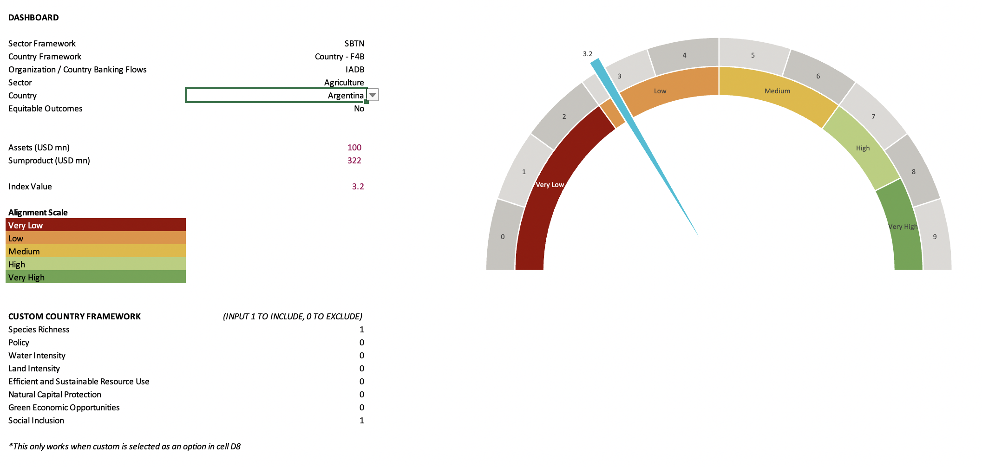
A DASHBOARD PRESENTS THE ALIGNMENT SCORE
Dial presents the overall alignment score. This can be viewed at an organizational level, and can be further flexed at an aggregate level or at sector/country level.
Users can select a sector framework, country framework, organization, sector and country

Slide 12
CASE STUDY - PUBLIC EXPENDITURE PLANNING
COUNTRY A:
AGRICULTURE
Finance and sectoral Ministries can use nature alignment scores when allocating resources and defining sectoral priorities.
The figures on the right show nature alignment across three sectors in Country A - agriculture, food and paper, and construction.
COUNTRY A:
FOOD AND PAPER
COUNTRY A:
CONSTRUCTION

Slide 13
THE TOOL HAS BEEN DEVELOPED IN CONSULTATION WITH KEY STAKEHOLDERS
TNFD
BIOFIN
IUCN
CBD Secretariat
OECD
IDFB
ETH Zürich/Crowther Lab
WWF
NatureAlpha
Governments (Environment and Finance Ministries)
Public Development Banks
Private Financial Institutions

Slide 14
THE NEXT FEW MONTHS WILL BE CRITICAL FOR LAUNCHING THE TOOL
Launch events at COP15 (10th & 12th December)
Possible event at WEF Davos (January 2023)
Pilot phase with Private and Public FIs from early 2023 onwards.
A limited number of pilot countries and FIs will be selected.
Additional donor funding will be needed to maximise the tool’s potential.

Slide 15
Comments are welcome, as are suggestions for collaboration, to the core Alignment Project Team.
Jeremy Eppel
Project Lead
jeremy.eppel@naturefinance.net
Matthew Doncel
Project Manager
matthew.doncel@naturefinance.net
Keep up to date with the work at https://www.naturefinance.net/making-change/data-disclosure-and-frameworks/finance-nature-alignment/

