Slide 1
Nature-related risks and the role of central banks Interface Dialogue Finance and Biodiversity (IDFB), 22 November 2022
Dr. Saskia de Vries
Head of department International Financial Architecture, De Nederlandsche Bank
Co-chair NGFS Task force on nature-related risks
Views expressed do not necessarily coincide with those of de Nederlandsche Bank or the Eurosystem

Slide 2
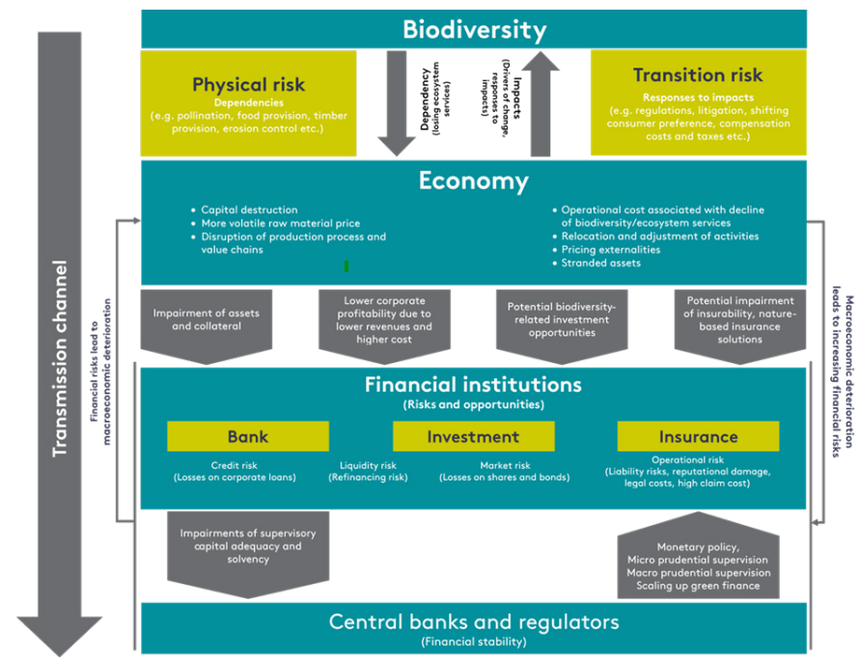
Biodiversity loss as a source of financial risk

Slide 3
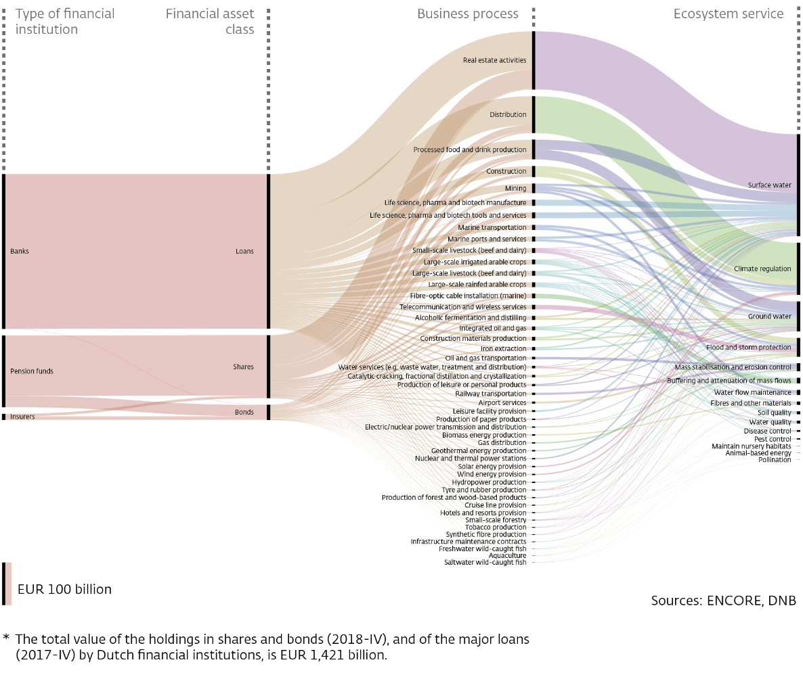
Dependence on ecosystem services: physical risk
3

Slide 4
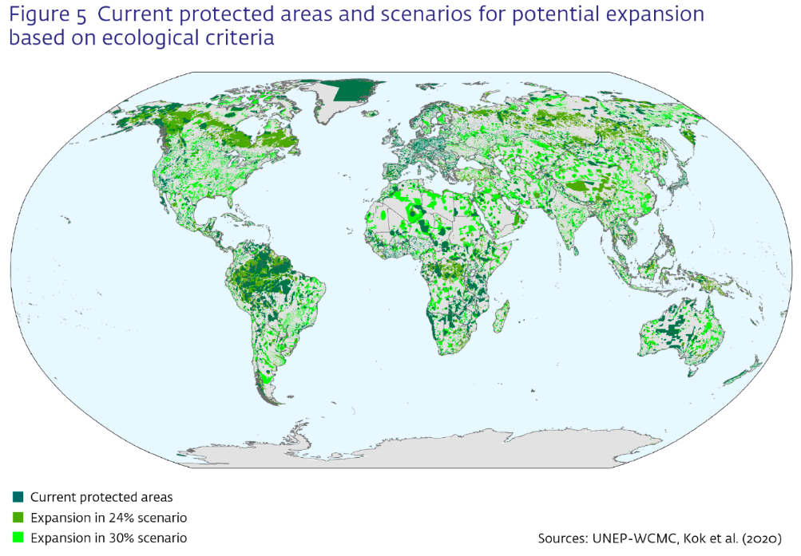
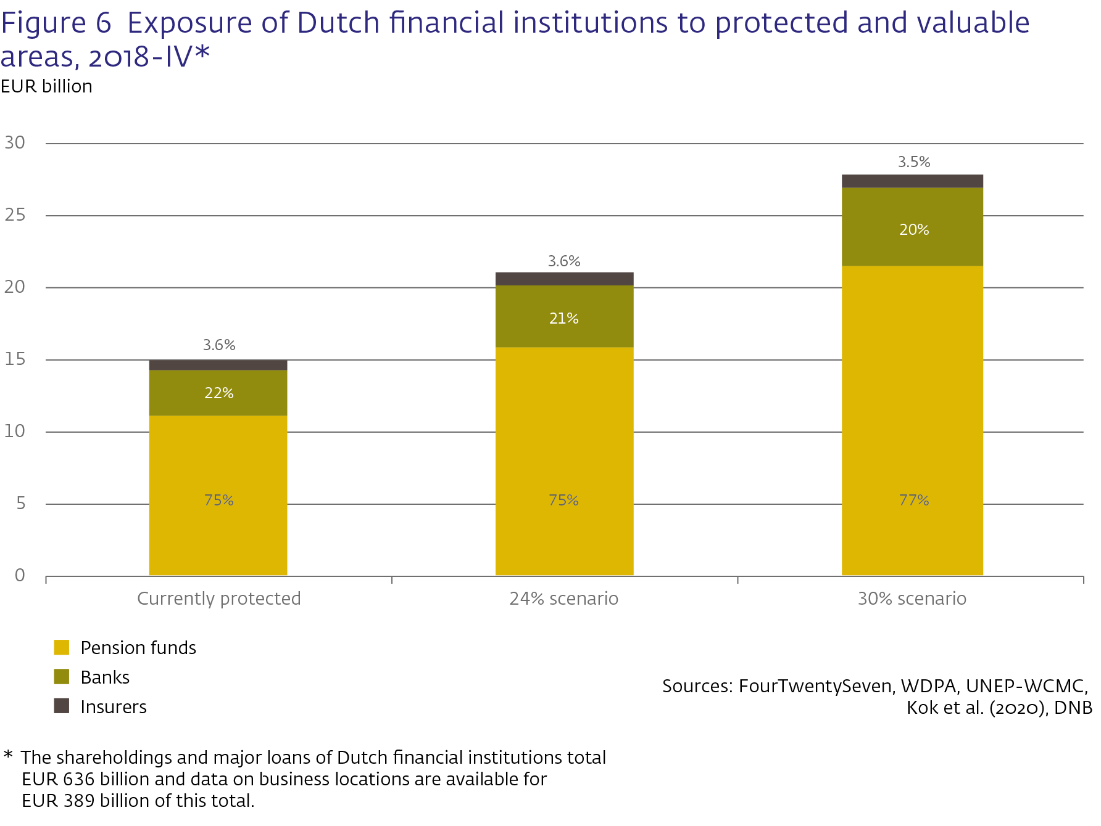
Financial institutions’ impact on biodiversity: transition risk
4

Slide 5
Central banks and financial supervisors are already acting

