Slide 1
UNDP-BIOFIN
Aligning finance flows from the global to local level with the GBF
Onno van den Heuvel
27 September 2022

Slide 2
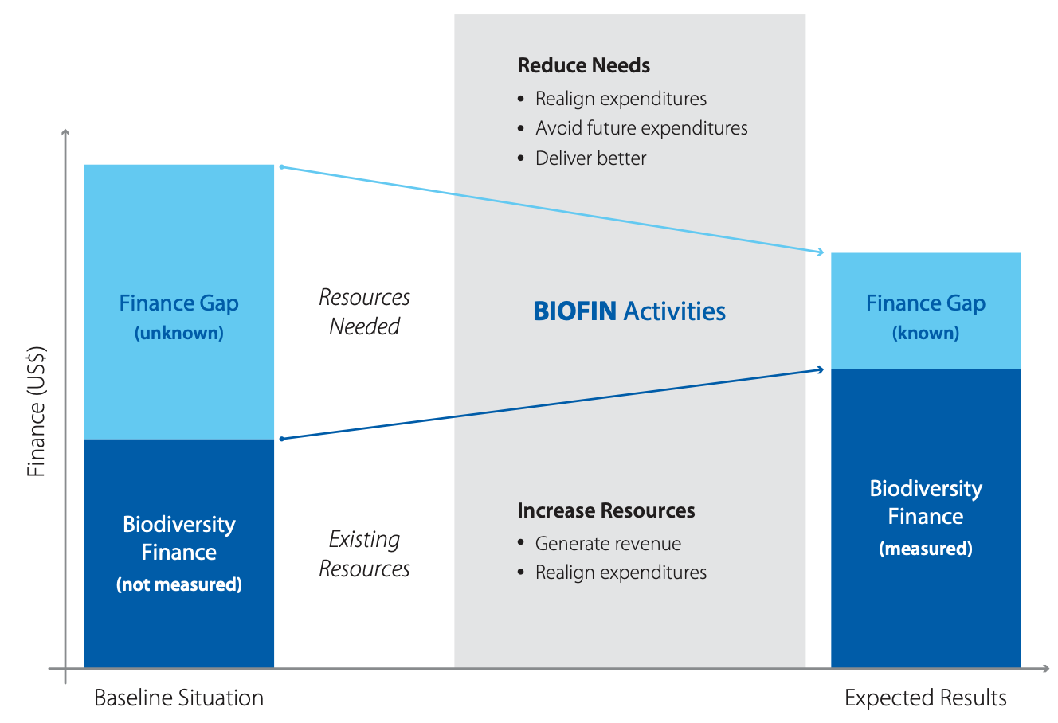
Theoretical Framework
Enhance positive flows, reduce negative flows

Slide 3
1. Global targets in the GBF
2. National Targets based on GBF in updated National Biodiversity Plan
7. M&E, scaling up
6. Alignment of local gov, private sector, NGOs, dev banks, ODA
3. Baseline data on positive flows and financial needs, main negative flows
5. Integrating national targets into (selected) national policies, plans, budgets, funds
4. National vision and action agenda for alignment through biodiversity finance plan

