Slide 1
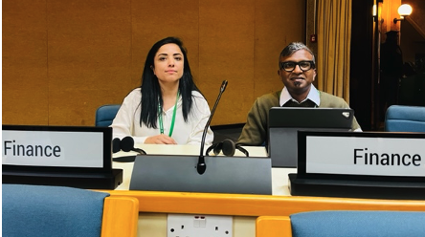
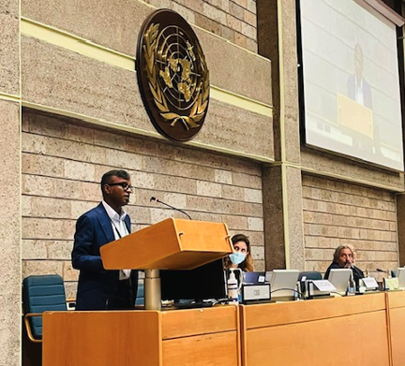
IDFB meeting #12
FfB Foundation actions towards CBD COP15 II
27 September 2022

Slide 2
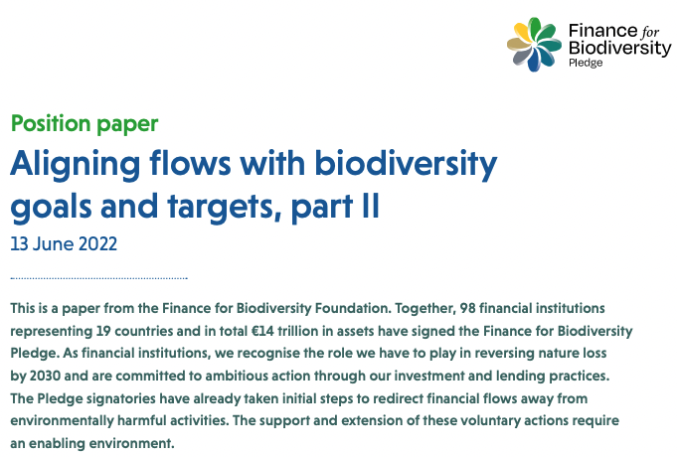
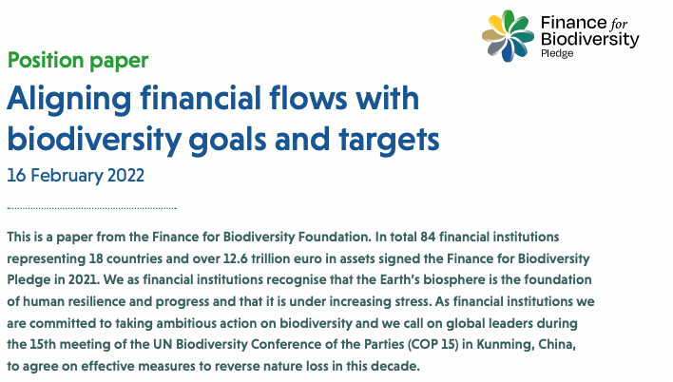
Public Policy Advocacy working group activities
Global Biodiversity Framework (GBF) negotiations:
Official CBD observer as FfB Foundation since 2021
Got two CBD finance chairs in 2022
Attended 3 Open-Ended Working Group meetings in 2021/2022 and published two position papers before the meetings
Engagement with negotiators ánd doing text suggestions on the following GBF parts:
Goal D aligning public and private financial flows
Target 14 enabling public policy environment of public and private financial flows aligning with the goals and targets of the GBF
Target 15 policy measures for mandatory and regular monitoring, assessment and disclosure for all businesses and financial institutions
2

Slide 3
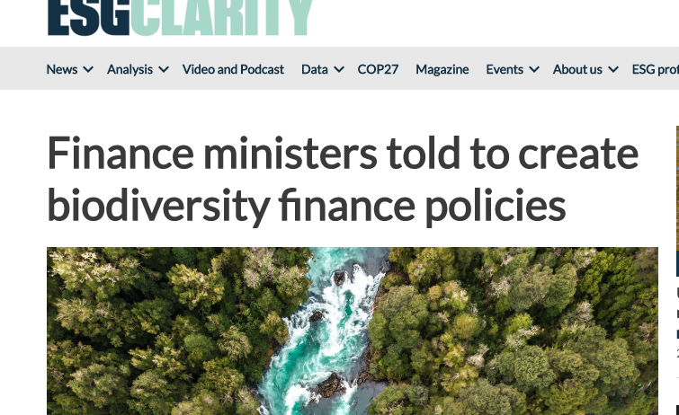
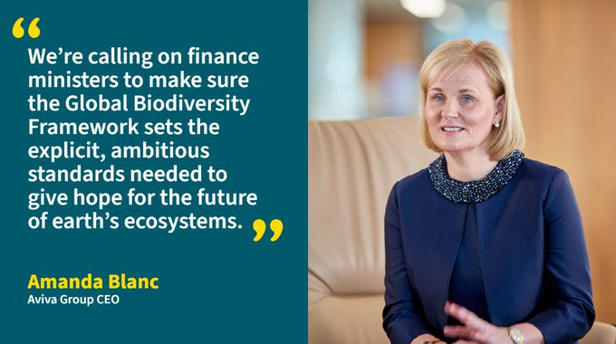
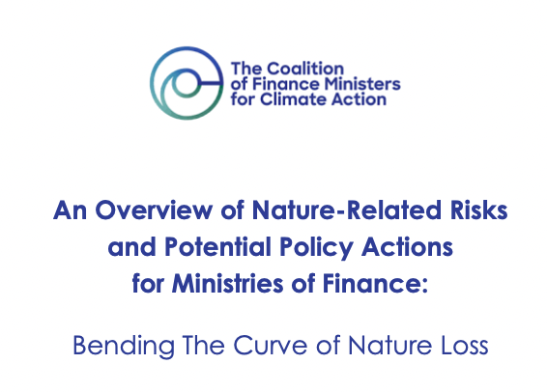
Finance ministers engagement
3 key messages for finance ministers:
Ensure that the ‘alignment of public and private financial flows with an ambitious Global Biodiversity Framework’ is a firm position taken by your governments in the negotiations at COP15
Invitation to join COP15 round table at Finance Day 14 December
Implement ‘aligning financial flows’ by:
- Setting Disclosure Regulations
- Requiring Transformation Pathways for the finance sector
- Integrating nature-related risks into Regulatory Frameworks
- Supporting Central Banks and Financial Supervisors
- Creating Economic Incentives for businesses and the finance sector
3

