Slide 1
INCREASING THE
NATURE ALIGNMENT
OF GLOBAL
FINANCIAL FLOWS
“
“
Aligning Global Finance with nature positive, equitable outcomes is at the core of NatureFinance’s mission.
New tools are needed to support this transition, so we will develop a first of its kind
Global Nature Positive Alignment Index and Dashboard

Slide 2
THE CHALLENGE - HOW TO...
Increase Materiality of Nature
Nature not currently material in financial decision making.
Standardise Metrics on Alignment
without an agreed international framework
The draft Post-2020 Global Biodiversity Framework calls for the alignment of financial flows across all levels of government and across all sectors of the economy, but without an agreed definition of nature positive.
Harness Growing Interest in Nature and Finance
Growing attention internationally to alignment of financial flows with nature-positive and net-zero outcomes not yet being translated into transition pathways.
Bridge Knowledge and Technical Gaps
A lack of understanding of what alignment entails and lack of an existing methodology for measuring nature-alignment of finance.
Broaden mindsets beyond a Resource Mobilisation lens
RM lens appears to offer more certain and direct flows of resources, while alignment can appear less certain and timely; both are needed, with alignment having potential to dwarf RM in scale of flows redirected to nature.

Slide 3
WHERE WILL THIS IMPACT?
Corporate Level
National Level
Global Level
Provide a robust quantitative approach for businesses and financial institutions to set nature positive goals and disclose progress.
Allow countries at all levels of economic development and richness of natural assets to assess how far their international and domestic policy commitments to nature positive alignment are being translated into action on the ground.
Show how far international policy frameworks under the UN CBD, UNFCCC, and other international agreements, as well as the GEF, are promoting greater nature-finance alignment in practice, and how and where they need to do more.
Gain new insights on how to deploy capital into specific sectors, countries, and asset classes and so raise the nature-positive alignment of portfolios.
Provide Civil society, academia and the media with new data and tools to hold countries and companies accountable
Allow for Regional and sectoral comparisons, and identify policy solutions to increase alignment
Enable ESG fund managers to measure and report on the nature alignment of their products

Slide 4
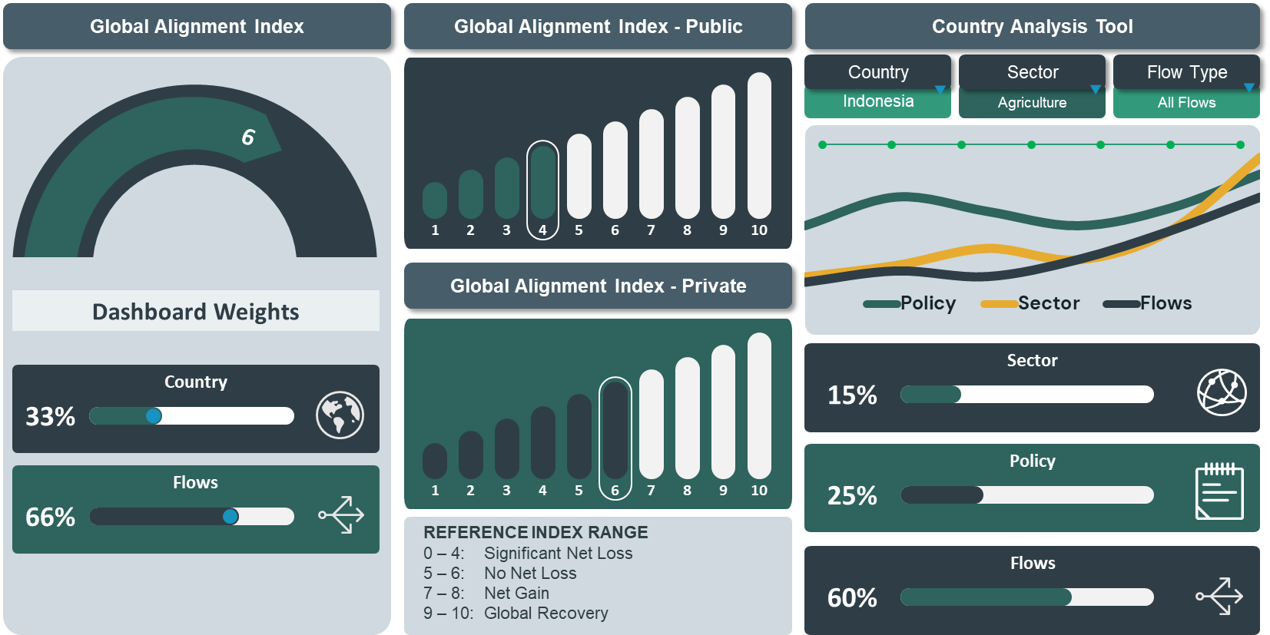
TRACKING NATURE-ALIGNMENT OF FINANCIAL FLOWS
Tools and approaches to measure the nature and scale of this misalignment are inconclusive and scarce.
NatureFinance aims to fill this gap through the development of an interactive dashboard and report on policy implications.
At the core of the Dashboard will be a Global Alignment Index, which will provide an assessment of the overall alignment between global financial flows and nature positive outcomes.

Slide 5
HOW WILL WE MEASURE AND REPORT?
An Index, Dashboard, and Policy Report will be created, applicable across international, national and corporate balance sheet levels, with options for online interrogation of the data at diferent levels of granularity.
INDEX
DASHBOARD
POLICY
RECOMMENDATIONS
A Global Alignment Index assessing the alignment between global financial flows and nature positive outcomes.
The Index will be granular to a public and private finance, global, national, individual financial institution or corporate entity level.
An interactive, web-based Dashboard built around the Global Alignment Index.
Allows the visual disaggregation of the Index by country, sector, and type of financial flow.
The "State of Nature Positive Financial Alignment” will be a policy report with a focus on actions needed by Governments, public and private FIs, etc. – to bring about positive change. Systemic policy interventions will help accelerate the nature positive transition.
ALIGNMENT

Slide 6
WHAT NEXT?
Aiming for launch at CBD COP 15 in Montreal, December 2022.
Significant addition to current work on alignment with a strong international policy framework under the UN CBD and UNFCCC.
Complements related work on green finance, including TNFD's nature-related risk management and disclosure framework.
Annual update of the Dashboard and Policy Report will track trends in financial alignment with nature positive outcomes and highlight key policy recommendations for improvement.

Slide 7
Comments are welcome, as are suggestions for collaboration, to the core Alignment Project Team
Jeremy Eppel
Project Co-Lead
jeremy.eppel@f4b-initiative.net
Nathalie Nathe
Project Co-Lead
nathalie.nathe@f4b-initiative.net
Matthew Doncel
Project Manager
matthew.doncel@f4b-initiative.net

