Slide 1
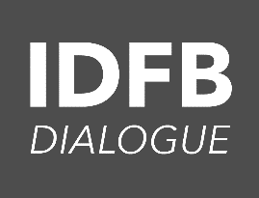
Interface Dialogue Finance and Biodiversity
Alignment of all Financial Flows
Common Ground document

Slide 2
Outline common ground document - Chapters
0 Introduction
1 The benefits of aligning all financial flows to the Global Biodiversity Framework (GBF)
2 The financial flows that need alignment
3 What are the key actors that are needed to align financial flows
4 Towards a more holistic and contextual approach
5 How to measure the alignment of all financial flows

Slide 3
Common ground document - paragraphs
Chapter 0 Introduction
Greening finance & financing green
About the IDFB and CBD
Biodiversity and Climate change
Chapter 1 The benefits of aligning all financial flows to the Global Biodiversity Framework (GBF)
1.1 Definition of Alignment
1.2 Alignment of flows and of incentives
1.3 Status in the negotiations on the GBF
Chapter 2 The financial flows that need alignment
2.1 Public finance for biodiversity market
2.2 Private finance for biodiversity market
2.3 Public-private finance for biodiversity market

Slide 4
Paragraphs - Continued
Chapter 3 What are the key actors that are needed to align financial flows
3.1 Ministries of finance, Central Banks and supervisors
3.3 Governments (e.g. budgets, ODA, subsidies, fiscal instruments etc.)
3.4 Private investors
Chapter 4 Towards a more holistic and contextual approach
4.1 Alignment with integrated goals and targets at the national level
4.2 Developing National Biodiversity Strategy and Action Plans (NBSAP)
4.3 Designing National Biodiversity Finance Plans (NBFPs)
Chapter 5 How to measure the alignment of all financial flows
5.1 Quantitative and qualitative approaches
5.2 Monitoring and review of the GBF
5.3 Measuring and monitoring at country and local levels

