Slide 1
From paris to kunming
The 8th Interface Dialogue Finance & Biodiversity
Rens van Tilburg
26 April 20202
Notes:
Introducing sfl and myself
This report: commissioned by PBL Netherlands Environmental Assessment Agency
Two things: also how climate and biodiversity interact
Today: what biodiversity can learn from the climate experience
Gap analysis
Dutch EU bias

Slide 2
presentation
Climate finance in practice
Biodiversity finance in practice
Conclusions
Recommendations private finance
Recommendations public finance

Slide 3
1. Climate finance

Slide 4
The financial promises in the climate agreements
In 2009 at COP15, developed countries committed to mobilizing USD 100 billion climate finance per year to developing countries by 2020.
The 2015 Paris Agreement reaffirmed this responsibility.
The 2015 agreement also explicitly stated that finance flows, also private ones, should be made consistent with low-GHG-emission and climate-resilient pathways.

Slide 5
The 100 billion dollar question
climate finance mobilized by developed countries, as defined by the climate accords, increased from $52.2 billion in 2013 to $58.6 billion in 2016 to $78.9 billion in 2018.
The upward trajectory appears to have continued in 2019 but at a pace not sufficient to reach the $100 billion in 2020.
According to Oxfam the real figure is about a third of this.
And the actual climate finance gap being 2,5 trillion, growing to 3,5 trillion 2030.
Notes:
(Bhattacharya et al., 2020).
https://www-nature-com.proxy.library.uu.nl/articles/d41586-021-02846-3

Slide 6
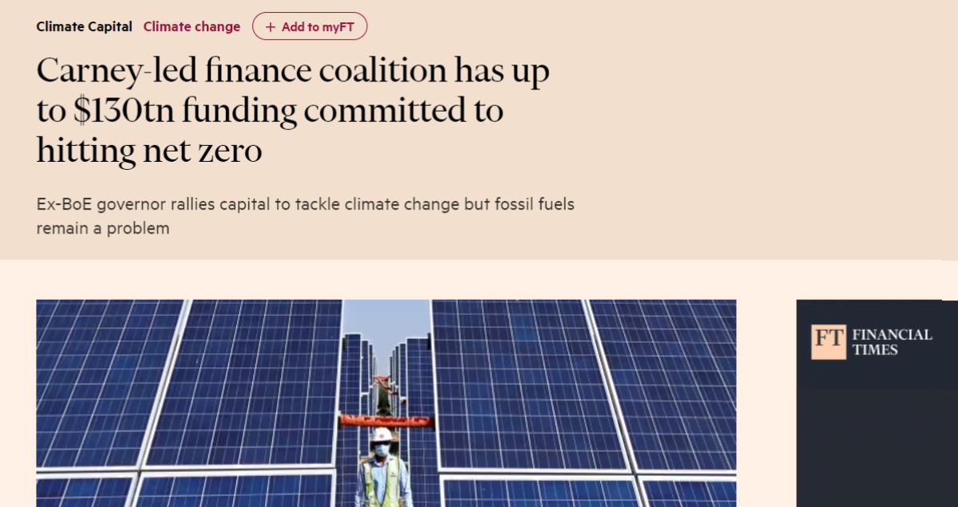
private finance: Glasgow Financial Alliance for Net Zero

Slide 7
private finance: climate action 100+
Initiative of 600+ investors worldwide managing USD 65 trillion of assets.
Engage cooperatively on the topic of climate change with some of the world’s 165 largest GHG emitters, covering 80% of global industrial emissions.
Engagement with the companies is a collaborative two-tier activity, spearheaded by a lead-investors, and backed by a group of investors.

Slide 8
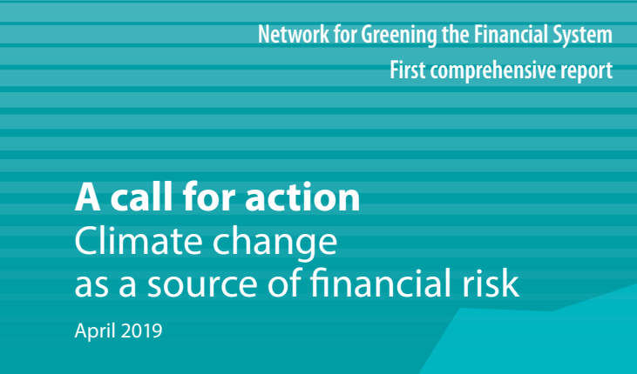
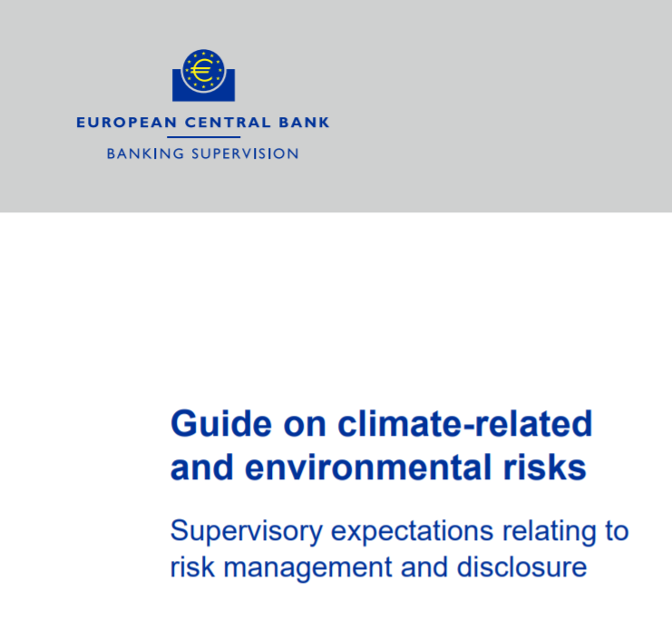
Supervision: supervisory expectations
Notes:
Frank Elderson: “Climate-related risks are a source of financial risk and it therefore falls squarely within the mandates of central banks and supervisors to ensure the financial system is resilient to these risks.”

Slide 9
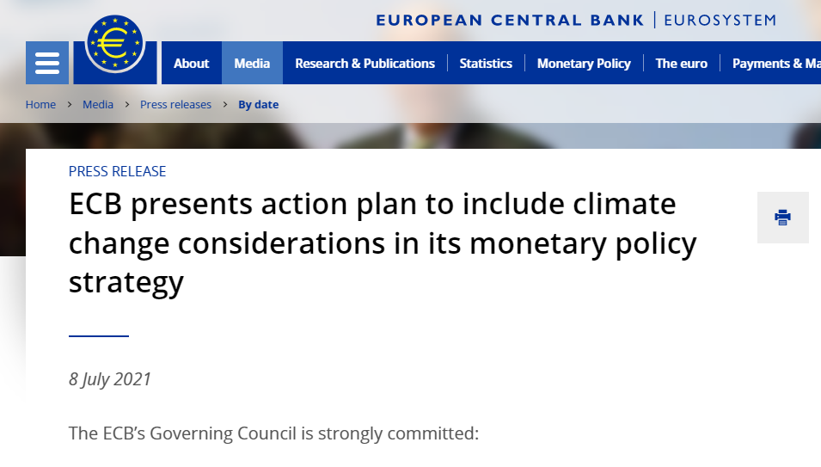
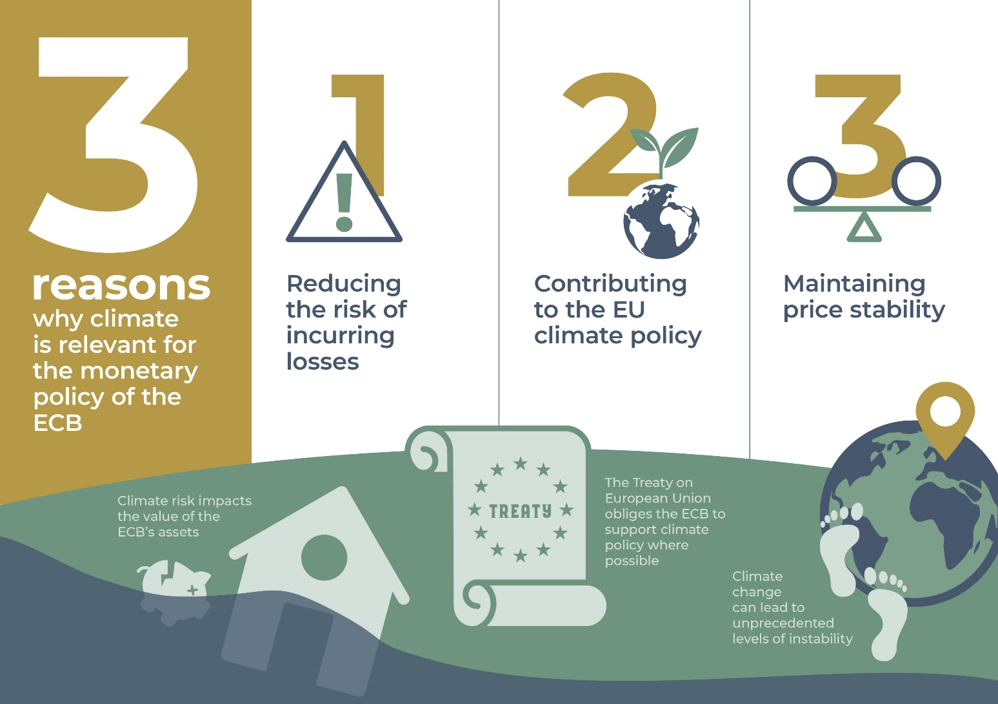
Monetary policy: an action plan for climate

Slide 10
Global monetary solutions
During the corona pandemic, like central banks, IMF issued new Special Drawing Rights (SDRs) equivalent to an amount of USD 650 billion.
Proposed the creation of the new Resilience and Sustainability Trust (RST).

Slide 11
3. Biodiversity finance

Slide 12
public finance:
national budgets
193 National Biodiversity Strategies and Plans.
40 UNDP-BIOFIN assisted National Biodiversity Finance Plans.
Developed countries failed to double biodiversity-related financial flows as agreed in 2010.
Biodiversity-relevant taxes represent only 1% of total environmentally related tax revenue.
Annually over USD500 billion of public spending harms biodiversity.
Notes:
Also subsidies and tax avoidance

Slide 13
Supervision and monetary policy: preliminary research

Slide 14
private finance: rewarding biodiversity performance
UPM, a Finnish pulp and paper maker took out a EUR750 million loan with BNP Paribas, the interest rate of which was linked to sustainability performance indicators, including having a net-positive impact to biodiversity in the Finnish forest (2020).
a.s.r., one of the biggest private landowners in the Netherlands, decided to provide leasers who manage their lands sustainably with a 5-10% discount (2021).
ASN Bank launched its Biodiversity Fund targeted at biodiversity restoration and conservation (2020).
Notes:
Not yet in sovereign debt

Slide 15
International finance: debt for nature swaps
Costa Rica received a USD 20 million debt write-off from the US and as a result received a total of USD 50 million investment to protect its natural habitats, doubling the size of marine protected areas and expand terrestrial parks.
Seychelles bought back a USD 21.6 million debt at a discount, and is paying off the amount to the Seychelles Conservation and Climate Adaptation Trust that in turn, finances marine conservation activities to keep 30% of its marine resources protected (2010).
Belize repurchased part of its foreign debt at a discount. USD 23 million of the savings is dedicated to protecting 30% of its waters (2021).

Slide 16
4. conclusions

Slide 17
conclusions
Finance has potent instruments at its disposal to preserve and restore biodiversity.
Companies can be stimulated and forced to change their ways or risk losing access to finance.
While awareness of biodiversity risks is rising fast on the financial agenda, the impact on the ground so far has been limited.

Slide 18
4. recommendations private finance

Slide 19
recommendations: private sector
1. Make biodiversity part of an integrated strategy with climate change.
2. Develop data and methodologies.
3. Create awareness at the executive level.
4. Map the hotspots in your portfolio.
5. Engage with the most heavily exposed companies.
6. Refrain from financing the most unresponsive companies.
7. Translate biodiversity performance into the cost of capital.

Slide 20
4. recommendations public finance

Slide 21
recommendations: Global Biodiversity Framework
Contain an explicit reference to aligning financial flows, both public and private, to its goals.
This should encompass both increased resource mobilization or naturepositive finance as well as adhering to the ‘do no harm’-principle.
Make goals specific and measurable along a clear timeline to allow the financial sector to benchmark its performance and thus determine its alignment.

Slide 22
recommendations: public budget
Create an international coalition of Finance Ministers for Biodiversity or extend the mandate of the current Coalition of Finance Ministers for Climate Action.
Test current expenditures, such as agricultural subsidies, on their climate and biodiversity impact.
Also use the public impact investment institutions (like international development banks). Leverage private funding through blended finance and subsidies or work with guarantees where necessary.

Slide 23
recommendations: supervision
Demand assessments of exposure to biodiversity from banks, pension funds and insurance companies, using existing methodologies.
Increase the capital requirements for the largest biodiversity risks.
Introduce minimum exposures for nature-positive and limits for nature negative loans and investments (macro prudential).
Add the knowledge of climate and biodiversity to the fit and proper test of key financial personnel.
Notes:
There is consensus over the fact that climate and biodiversity pose both micro- and macroprudential risks. Risks that cannot be completely quantified. Therefore, steps need to be taken to align the
current supervisory framework with the need to reduce these risks. To this end, in addition to what is already done with regard to climate:

Slide 24
recommendations: monetary policy
Include biodiversity in the review of collateral framework and asset purchase programme, starting with differentiating between the best and worst performing sectors and companies.
Also do this for the refinancing operations of banks and target these to nature-positive bank lending.
Own funds: Promote positive nature impact also through own nonmonetary portfolios.

Slide 25
recommendations: Enable investments everywhere
Biodiversity in Debt Sustainability Analyses.
Sovereign debt pricing based on biodiversity performance.
Biodiversity as an integral part of debt restructuring. Nature-positive structural adjustment plans. Nature-for-debt swaps.
New global liquidity (SDR’s) as reward for the preservation and restoration of biodiversity.

Slide 26
Thank you please stay in touch!
Rens van Tilburg
r.tilburg@uu.nl
www.sustainablefinancelab.nl

