Slide 1
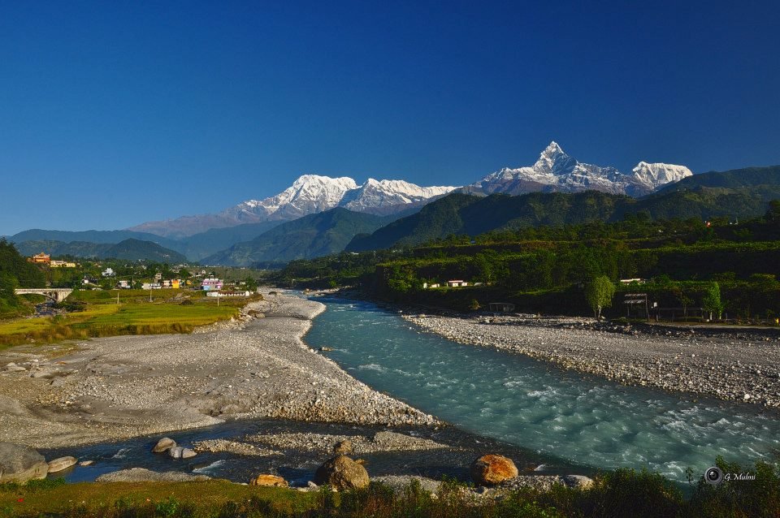
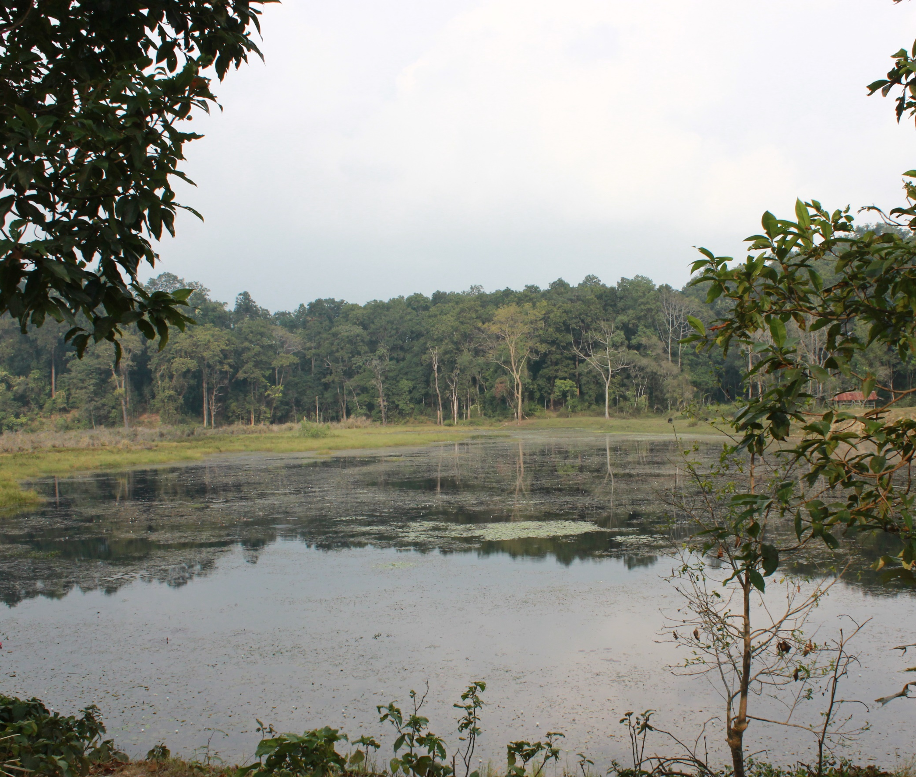
Biodiversity Finance in Nepal: Challenges and Opportunities
Interface Dialogue Finance and Biodiversity
Dhananjaya Paudyal
Joint Secretary / CBD National Focal Point
MoFE, Nepal
25th Jan 2022

Slide 2
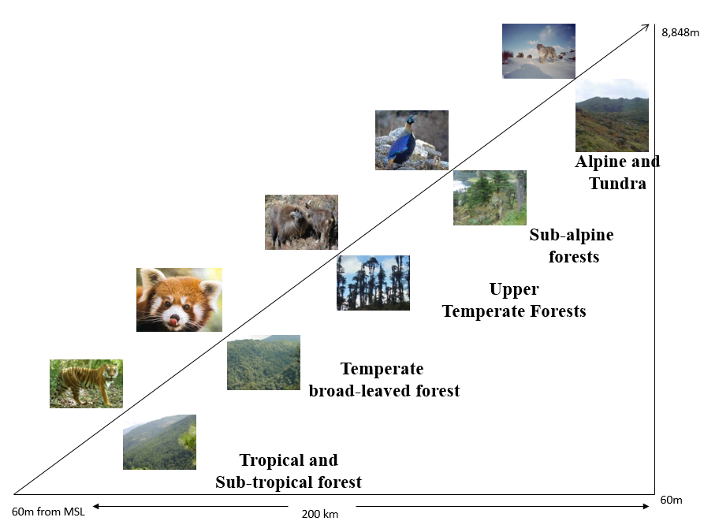
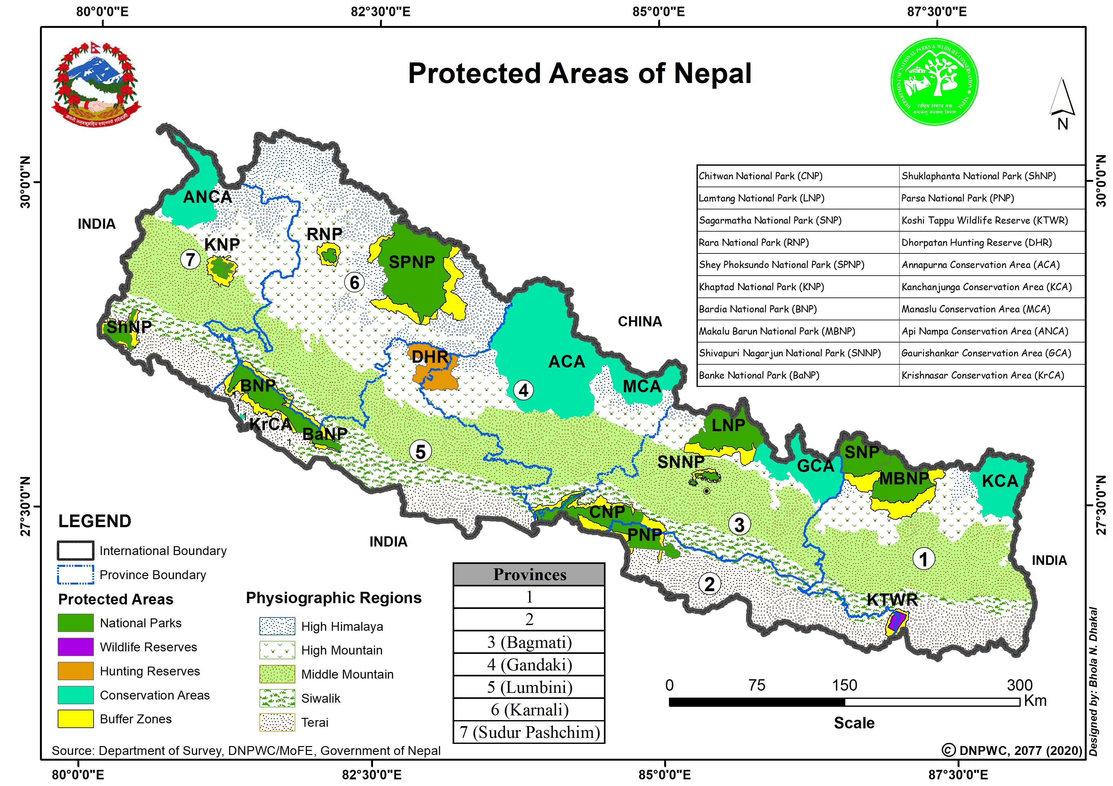
Biodiversity in Nepal
Nepal, unique geography with its dramatic changes in elevation along the relatively short (150-250 km) north - south transect and associated high variability in the physiographic and climatic conditions, gifted with rich biodiversity resources
Although, it occupies 0.1% of global area, it is home to 3.12% and 1.1% of the world’s flora and fauna respectively
Status of Nepal’s species diversity - flora 11971 and fauna 11861 species, total: 23832 species (NBSAP 2014-2020, GoN, MFSC, July 2014)

Slide 3
Biodiversity in Nepal…
Protected areas (23.39% of the land area of the country) have been declared over the country with primary objective to conserve representative biodiversity, ecosystem and genetic resources (20 PAs: 12 NPs, 1 WLR, 1 HR, 6 CAs incl. BZ)
Forests - 44.74% land area (2015)
Moreover, wetlands (5% area), rangelands (12% area), agricultural sector and mountains (15% area) represent the biodiversity at ecosystem, species and genetic levels (CBS, 2013)
Agro-biodiversity – covering about 28% area (cultivated 21%, uncultivated 7%, overlaps with rangelands, wetlands and mountains)

Slide 4
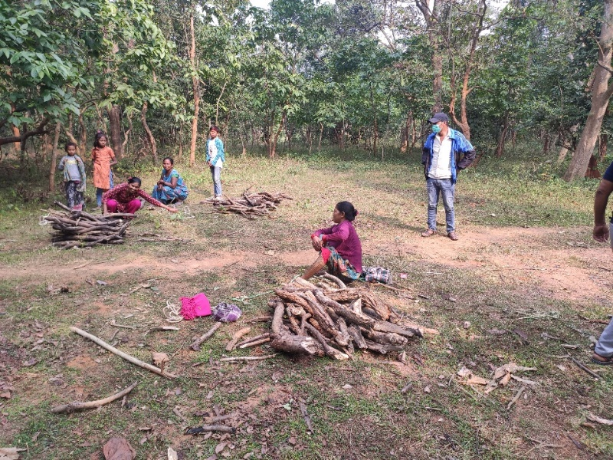
Efforts and achievements
As a party to CBD, committed to implement its objectives and NBSAP into ground by creating enabling policy, laws, institutions and programmes
National Biodiversity Strategy and Action Plan (NBSAP) (2014-2020):- conservation of biodiversity for sound and resilient ecosystems and national prosperity (vision)
Strong law enforcement, habitat management, enhanced transboundary cooperation and community participation have resulted considerable increase in number of flagship wildlife species, such as Royal Bengal Tiger (235), One horned Rhinos (752), Common Leopard, Snow Leopard, Black Buck, Ghariyal, Wild Buffaloes
More than 30,000 Community-based Forestry Groups involved in biodiversity conservation (>25% forest area)
Altogether 27 species conservation action plans prepared and being implemented (17 fauna and 10 flora)

Slide 5
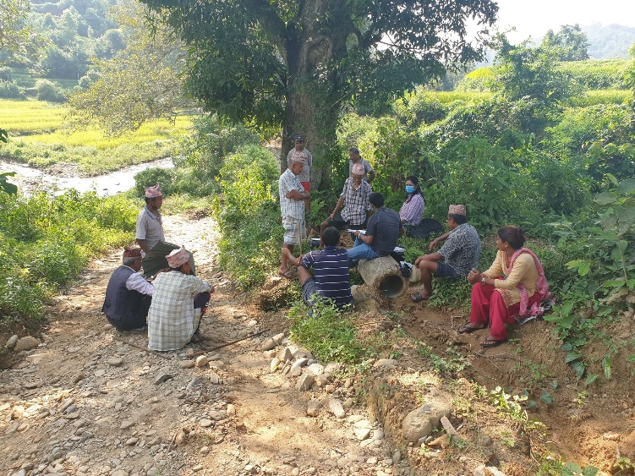
Efforts and achievements
Started sharing the 50% revenue generated from Protected Areas to local communities for conservation, livelihood improvements and community development
Incentive driven interventions and wildlife damage relief fund are giving local people a stake in biodiversity conservation and generating stewardship
Encouraging results have been witnessed in conserving agro-biodiversity front as well, e.g., established 40 community seed banks and stored 2045 accessions representing 47 different crop species
A total of 24,683 accessions of Nepalese crops, forages and microbes have been conserved in different international and foreign gene banks

Slide 6
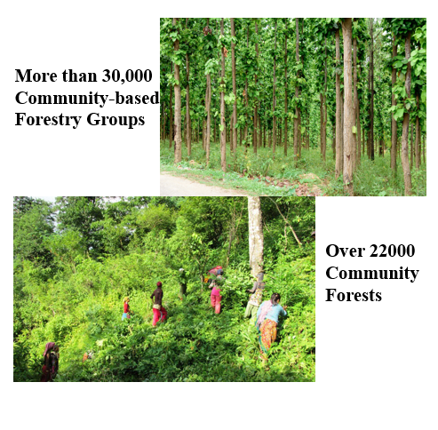
Progress in ABTs
Six national report to the CBD (2018) and Country Position Paper (CPP) as a country preparedness towards the CBD COP15
In Nepal, out of 58 indicators mentioned in the NBSAP (2014-20) to meet 20 ABT:-
3 (5.2%) achieved before the deadline of 2020
12 (20.7%) on track to achieve the targets by 2020
38 (65.5%) indicators on progress but at an insufficient rate
5 (8.6%) indicators no significant progress
None of the indicators showed moving away from the target (MoFE, 2018)
Of the 20 Aichi Biodiversity Targets, 9 targets (45%) are likely to be achieved, whereas 1 target (5%) has achieved before deadline and the progress has been at in-sufficient rate for 10 targets (50%)

Slide 7
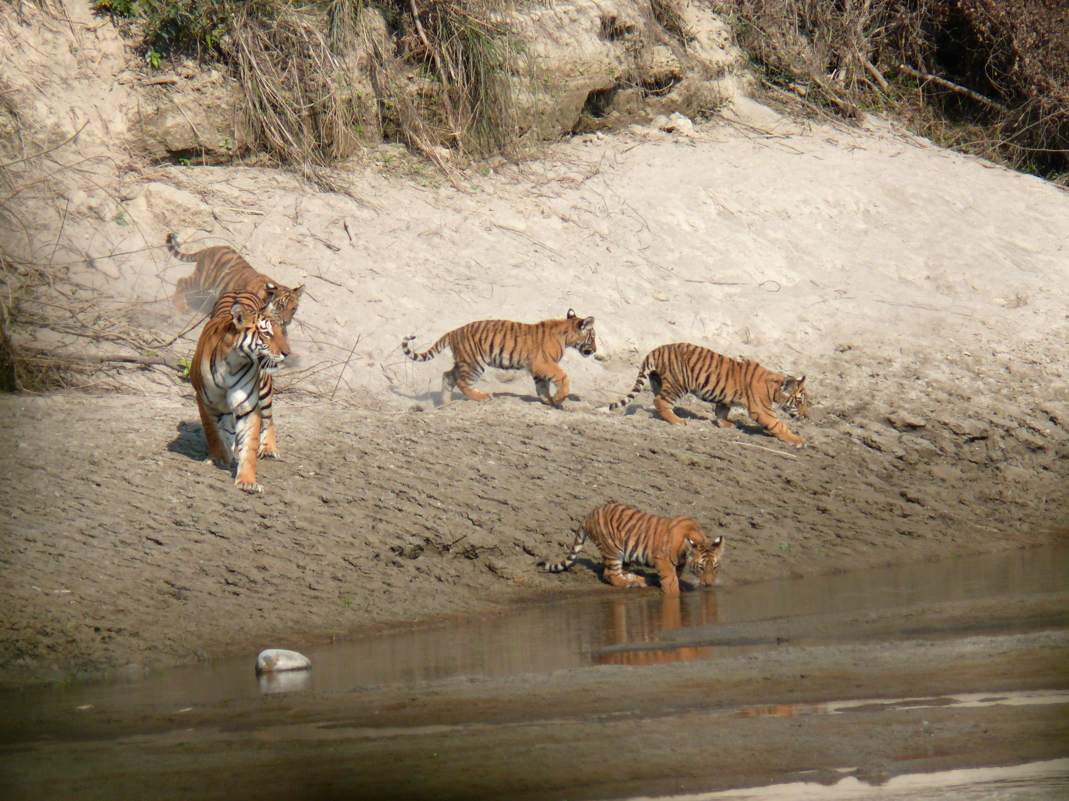
Major Issues in Biodiversity Conservation
Natural and anthropogenic factors - floods, uncontrolled forest fires, unplanned infrastructure development, poaching, climate change and illegal wildlife trade collectively pose serious threats to terrestrial and aquatic biodiversity and their habitats.
One of the challenges we have witnessed these days is the conflict between escalating dispersal wildlife population outside of protected areas and the local people

Slide 8
Biodiversity and Finance
MoFE with technical assistance from the UNDP initiated the Biodiversity Finance Initiatives to estimate the current biodiversity expenditure and finance gap, and identify the potential finance solutions to address the biodiversity threats / improve biodiversity outcomes
Total financial requirement for implementing NBSAP (2014-2020) was NRS 70448 million (~585 million $, ~83 million $/year), of which majority should come from the public expenditure (55%), one third from conservation partners (35%), nearly one tenth (8%) from others (community institutions) and rest 2% from private sector
Preliminary review (work in progress not for citation) biodiversity relevant expenditure during the NBSAP period was NRs 40609 million (~338 million $, ~48 million $/year), where contribution form the government (55%), conservation partners (37%) and others (8%) were also equal as envisioned by the plan. Private sector investment could not be estimated.

Slide 9
Biodiversity and Finance
This study reveals financial gap for investment in biodiversity conservation was NRs 29839 million. The country was able to spend about 58% of the fund envisioned by the NBSAP
However, biodiversity relevant expenditure during the NBSAP period doesn’t account the investment of the community institutions
In Nepal, more than 2.1 million ha of forests are handed over to the local communities, which is nearly one third of the national forest area
According to the forestry legislation, community-based forests institutions can sale the forest products and utilize the income on the forest conservation, including community development as per the approved plan
The study also reveals that community institutions are mobilizing nearly NRs 7000/ha in biodiversity related expenditure, i.e., more than half of the total income from the forests
When this figure is used to estimate national contribution from community institutions, it reaches to NRs 15859 million/year

Slide 10
Private Sector Expenditure in Biodiversity
Six sector, 26 institutions
Biodiversity Expenditure
No direct investment
In-direct contribution (through CSR fund)
Investment: Awareness, restoration
Sector | Dependency on Biodiversity resources | Biodiversity Safeguard compliance | Investment on Biodiversity related activities
Finance (5) | Low, (indirect) | High | Limited
Tourism (4) | High (Direct) | Low | Virtually none
Forest based industries (3) | High (Direct) | Low, virtually none | Virtually none
Industries (3) | Medium | Low | Virtually none
Transport (4) | Low (Indirect) | Medium (Vary) | Virtually none
Hydropower (3) | High (Direct) | Medium (Vary) | Virtually none
BIOFIN Case study, 2020

Slide 11
Challenges in private sector investment
Accounting biodiversity loss during investment decision
Ignorance of the biodiversity value during appraisal
Hydropower development inside protected area
Incentivising “private sector” – Reward
Why should I invest if others are not doing?
Disclosure of information
Reluctance to share financial information
Appropriate institutional mechanism for accessing finance
I want to invest, where shall I deposit money? How I am sure that fund will be used for the conservation purposes
Compliance monitoring
Amount of the fine is far less than cost of environment management plan implementation

Slide 12
Opportunities in private sector investment
Conducive policy and legal framework
Compensatory payment
Enabling policy environment for mobilising CSR Fund
Industrial Enterprise Act
Bank and Financial Institution Guidelines (1% of Profit)
Growing awareness/responsive business culture
Environmental screening from the Bank and Financial Institutions
Compliance with national environmental safeguard

Slide 13
Future Priority
Financing Green – Priority to the financing projects that
Contribute to the conservation, and sustainable use of biodiversity and ecosystem services
Greening finance – Avoid financing project having adverse consequences
AVOID- MITIGATE - COMPENSATE
Developing policy and institutional measures for “attracting investment”
Green certification schemes
Mobilising private sector resources in biodiversity (Priority Finance Solution)
Operationalize mechanism of mobilizing CSR fund of bank and financial institutions for financing biodiversity sector (Approx. financial value is NRs 59.6 million/year)
Mobilizing private insurance companies in wildlife-related losses and damages compensation (Insurance premium support) (Approx. financial benefit – NRs 100 million/year)

Slide 14
Future Priority
After endorsement of Post 2022 GBF, NBSAP will be prepared and implemented
Our priority will be an efficient utilisation of the existing resources, including re-aligning expenditure on biodiversity
30x30 Global Target, OECMs and national guidelines
BIOFIN study has identified prioritized finance solutions, which will be resource mobilization strategy for achieving the post 2020 GBF targets ***
Team is still working on estimating the financial value, preliminary estimate of the additional biodiversity finance in the country would be more than NRs 40,000 million (over the next 5 years), by mobilizing private and community sources including greening of the agricultural subsidies of the government

Slide 15
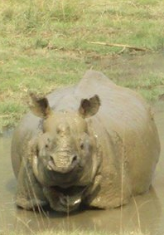
Thank You

